Slide 1
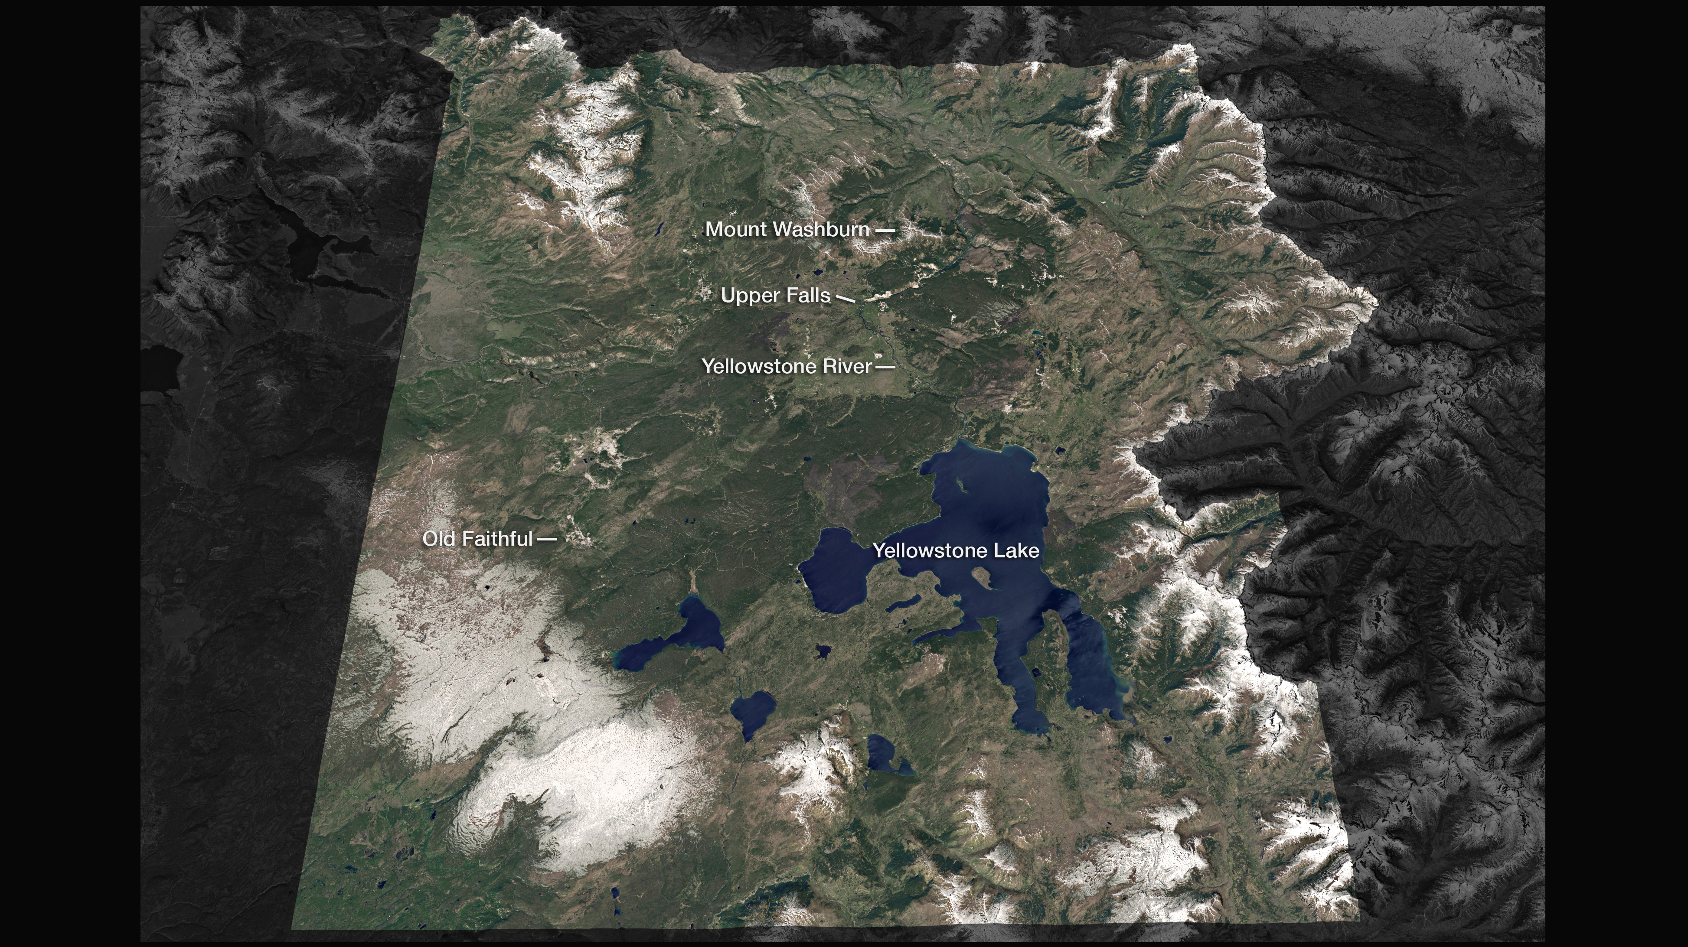
Notes:
Highlighting National Parks on the National Park Service Centennial
Yellowstone National Park, image acquired by Landsat 8 OLI on June 9, 2013 and overlaid on a digital elevation model created with data from the ASTER instrument on Terra
For more information:
http://earthobservatory.nasa.gov/IOTD/view.php?id=87881

