Slide 1
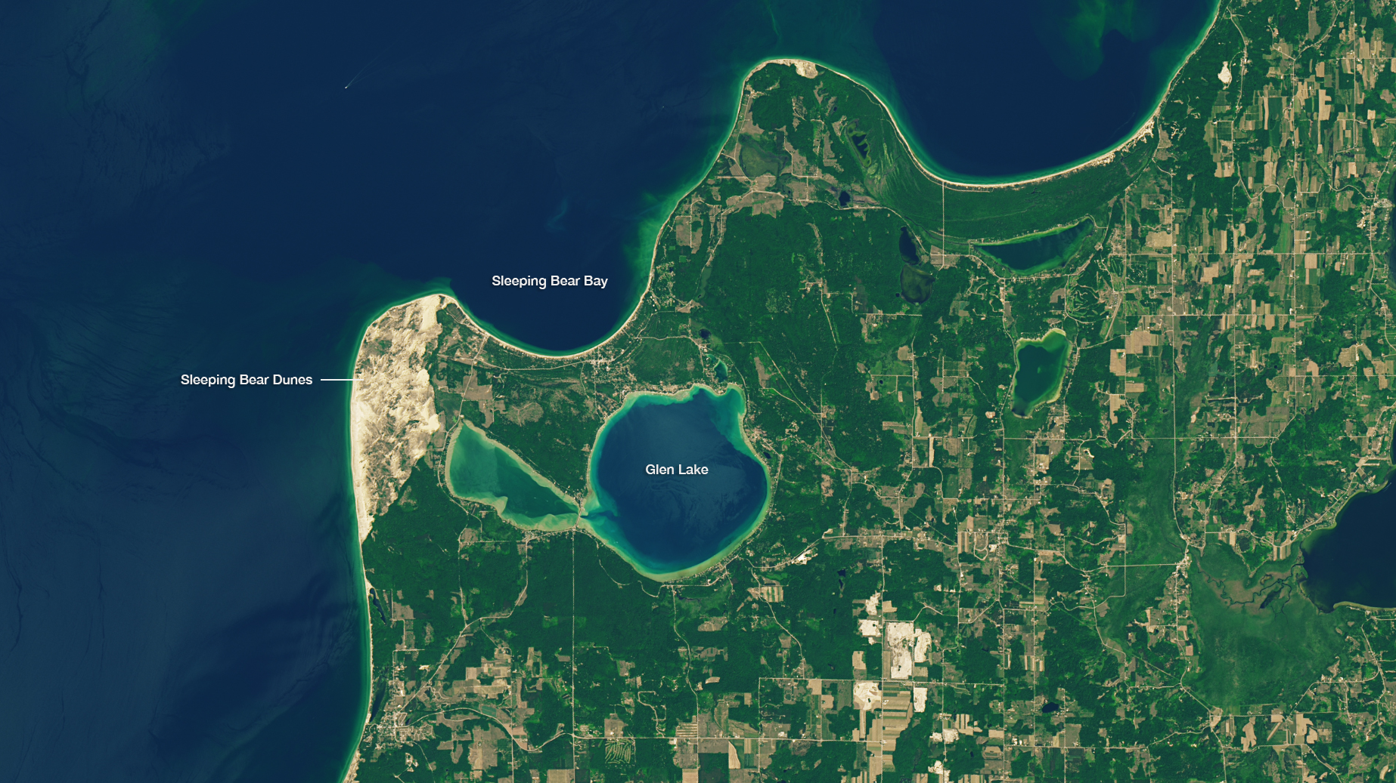
Notes:
Highlighting National Parks on the National Park Service Centennial
Sleeping Bear Dunes National Lakeshore, acquired by Landsat 8 OLI on June 17, 2016
For more information:
earthobservatory.nasa.gov/IOTD/view.php?id=88256

