Slide 1
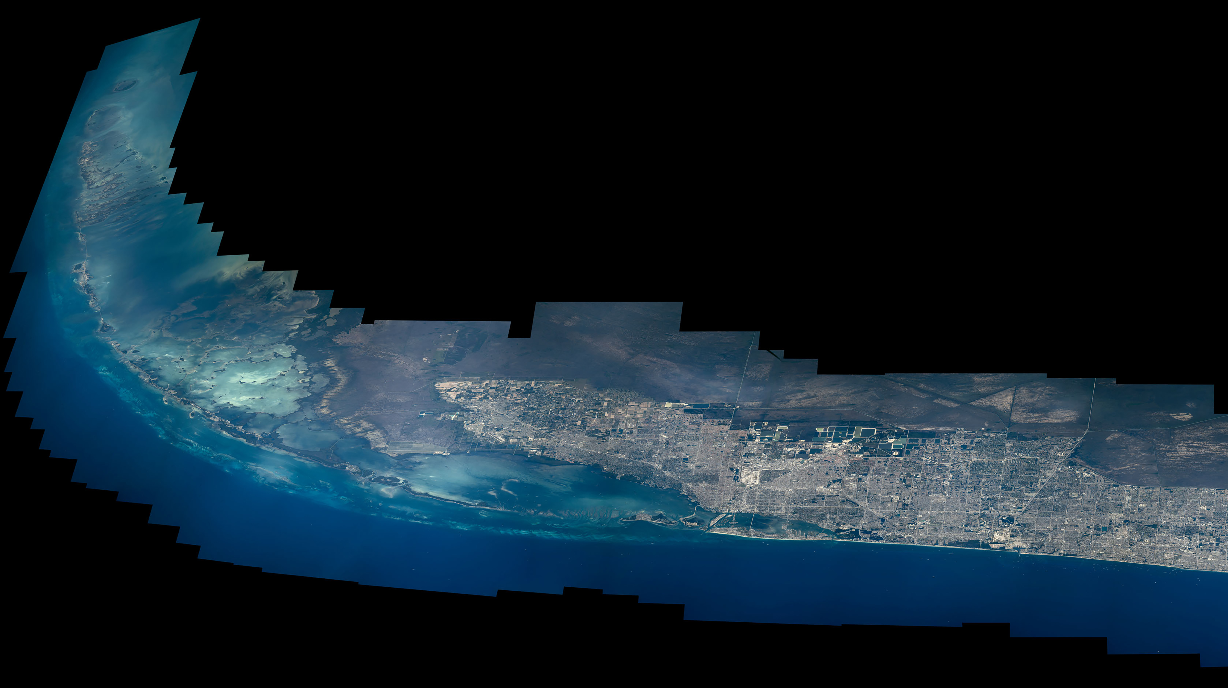
Notes:
Highlighting National Parks on the National Park Service Centennial
NASA astronaut Jeff Williams took the brilliantly colored photographs, assembled into this composite image, during his Expedition 47/48 mission aboard the International Space Station in 2016. Sharing on social media, Williams wrote, "<b>Florida Bay to Anhinga Trail @EvergladesNPS</b>. #FindYourPark #NPS100" Additionally, Williams posted a video highlighting the wildlife protected areas in the merged panorama.
For more information:
https://www.nasa.gov/image-feature/finding-your-park-from-the-space-station-everglades

