Slide 1
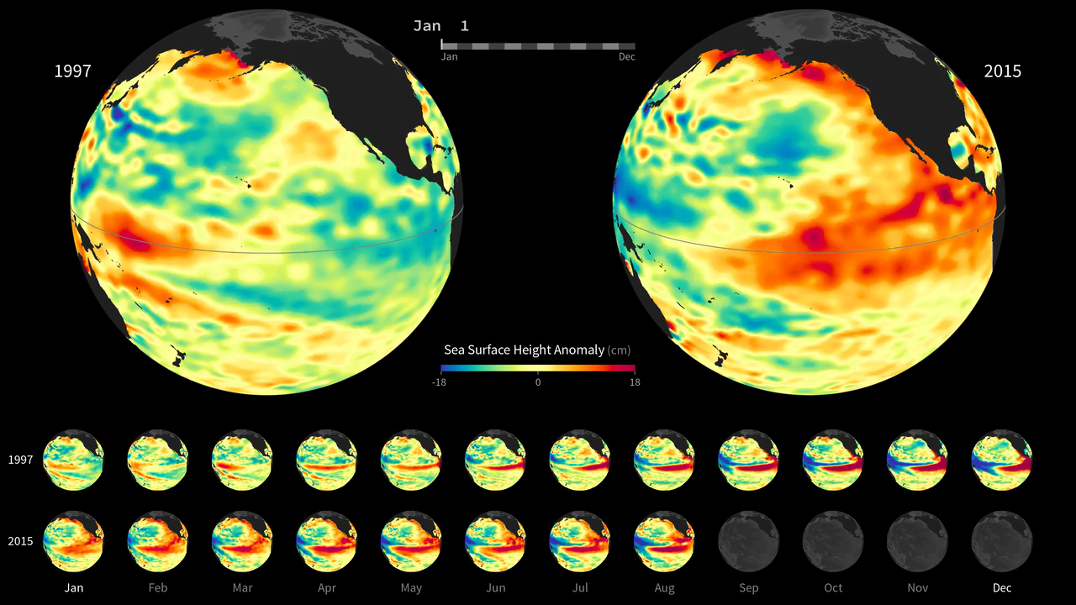
Notes:
El Niño Watch 2015
Interest in the developing 2015 El Niño is high, as the strength of this year’s event will influence how much rain and snowfall states like California receive this winter. Strong El Niño conditions typically result in wetter weather patterns along the United States west coast, which could help to ameliorate the ongoing drought. A statement issued by the National Oceanic and Atmospheric Administration (NOAA) Climate Prediction Center on August 13, 2015, reports that “there is a greater than 90% chance that El Niño will continue through Northern Hemisphere winter 2015-16, and around an 85% chance it will last into early spring 2016.”
El Niño is characterized by unusually warm ocean temperatures in the Equatorial Pacific. Conditions in 2015 bear some similarities to those of 1997, a year that brought one of the most potent El Niño events of the twentieth century. This visualization provides side-by-side comparisons of Pacific Ocean <i>sea surface height anomalies</i> (SSHA) in 2015 [<i>right</i>] with SSHA during the famous 1997 El Niño [<i>left</i>]. Red shades indicate where the ocean stood above normal sea level because warmer water expands to fill more volume (thermal expansion). Blue shades indicate where sea level and temperatures were lower than average (thermal contraction). Normal sea-level conditions appear yellow. The maps—based on altimetry data collected by the TOPEX/Poseidon (1997) and OSTM/Jason-2 (2015) satellites—have been processed to highlight the interannual signal of SSH, i.e., the mean signal, seasonal signal, and the trend have been removed.
For more information:
sealevel.jpl.nasa.gov

