Slide 1
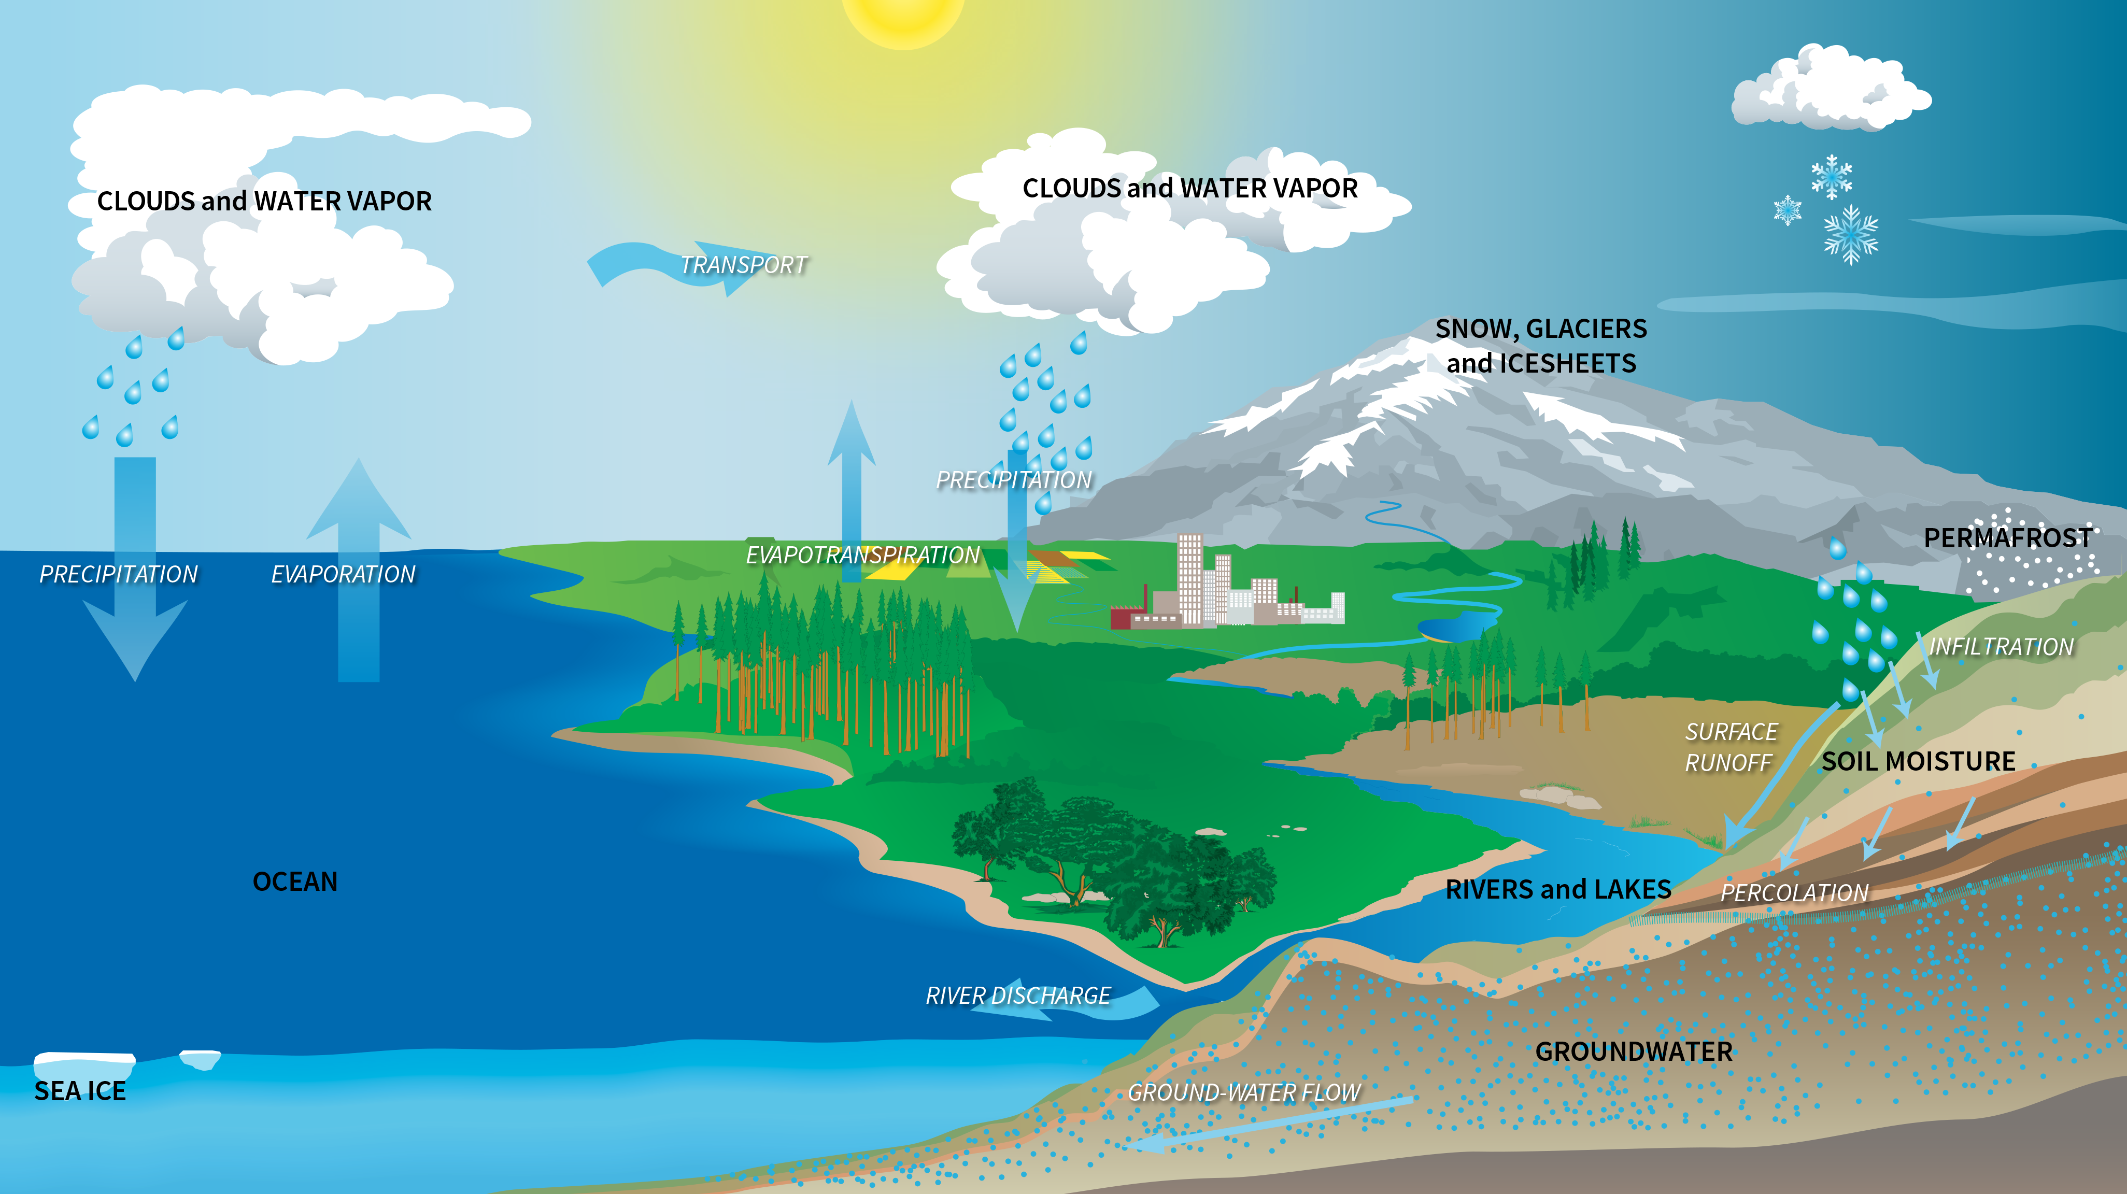
Notes:
The Water Cycle
Diagram of the water cycle.
The water cycle describes how water evaporates from the Earth’s surface, rises into the atmosphere, cools, condenses to form clouds, and falls again to the surface as precipitation. About 75% of the energy (or heat) in the global atmosphere is transferred through the evaporation of water from the Earth’s surface. On land, water evaporates from the ground, mainly from soils, plants (i.e., transpiration), lakes, and streams. In fact, approximately 15% of the water entering the atmosphere is from evaporation from Earth’s land surfaces and evapotranspiration from plants. Such evaporation cools the Earth’s surface, cools the lower atmosphere, and provides water to the atmosphere to form clouds.

