Slide 1
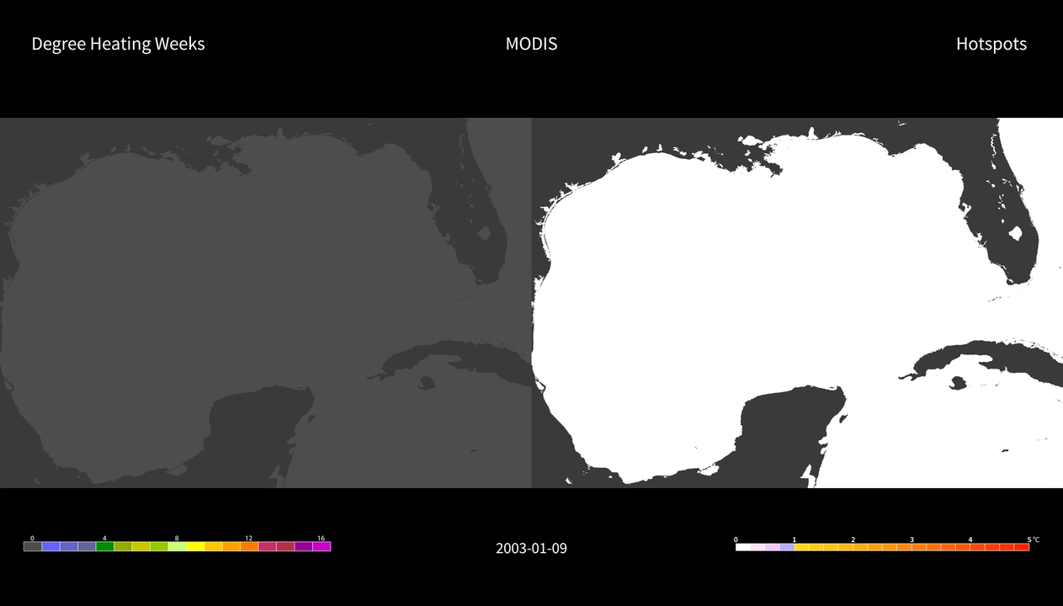
Notes:
Thermal Stress off Florida's Coast
AVHRR HotSpots are the difference between the AVHRR nighttime-only SST and the AVHRR climatology, while MODIS HotSpots are the difference between the MODIS Aqua 11 µm nighttime-only SST and the AVHRR climatology.

Slide 2
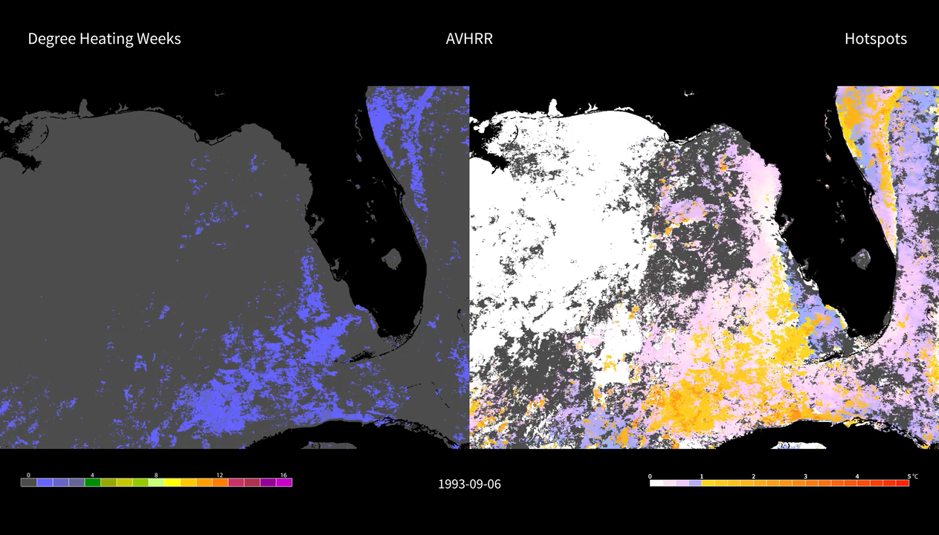
Notes:
Both Degree Heating Weeks (DHWs) products count positive HotSpots equal or higher to 1°C in a 12-week window. When DHW values are between 4 - 8, significant coral bleaching is likely, and the potential for coral disease increases. DHWs values higher than 8 indicates where mass coral bleaching and significant mortality are likely.

