Slide 1
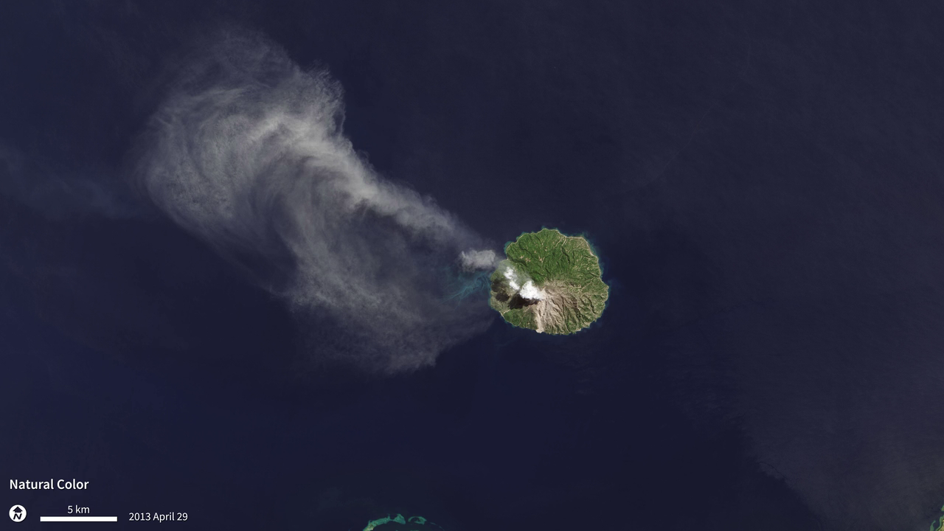
Notes:
As the Landsat Data Continuity Mission—now renamed Landsat-8—flew over Indonesia’s Flores Sea on April 29, 2013, the satellite’s Operational Land Imager (OLI) and Thermal Infrared Sensor (TIRS) captured these images of the Paluweh volcano spewing ash. The OLI captured the natural-color image that shows the white cloud of ash drifting northwest over the darker forests and water, while TIRS detected thermal infrared radiation, or heat, from the scene. The TIRS image reveals a hot spot (bright white) where lava was oozing out near the top of the volcano, surrounded by cooler ash clouds (dark gray). The image pair illustrates the value of having both OLI and TIRS on Landsat-8 and highlights TIRS ability to detect very small changes in temperature over small distances—down to about a tenth of a degree Celsius.

