Slide 1
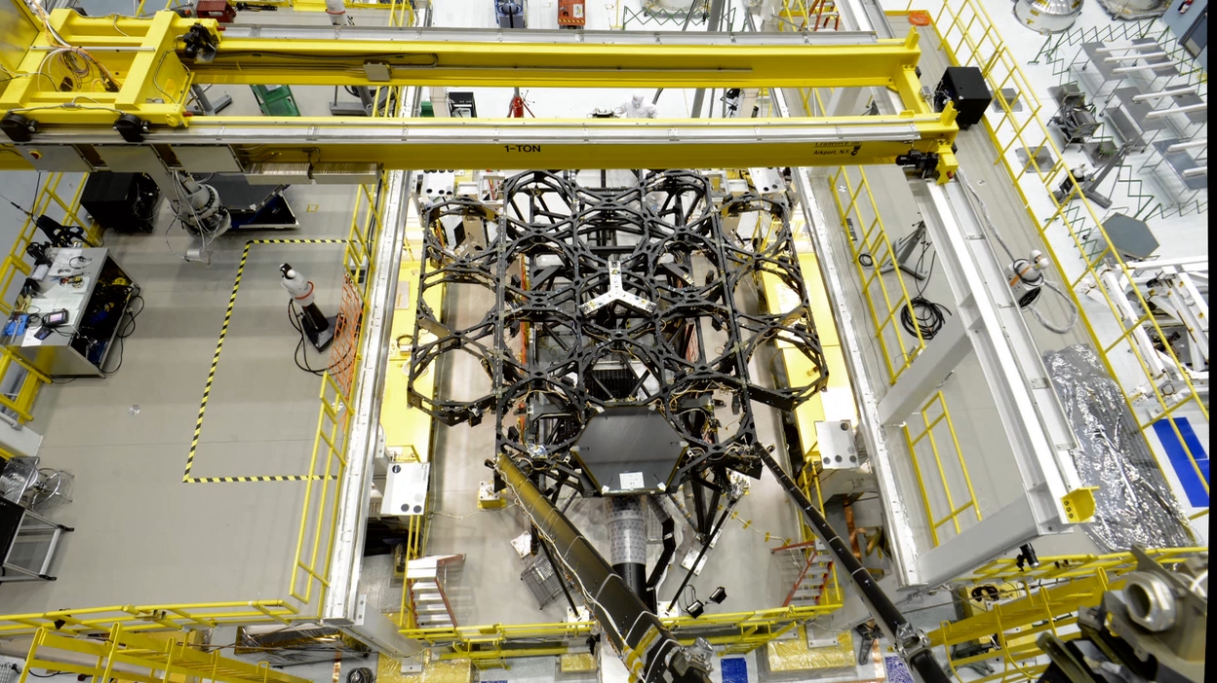
Notes:
A time laspe video of showing the installation of the 18 mirror segments of Webb Telescope's primary mirror. The time lapse master used to create this video contains more than 160,000 images. At 30 frames a second, it runs about 1 hour and 20 mintues long. This is an edited version of that master

