Slide 1
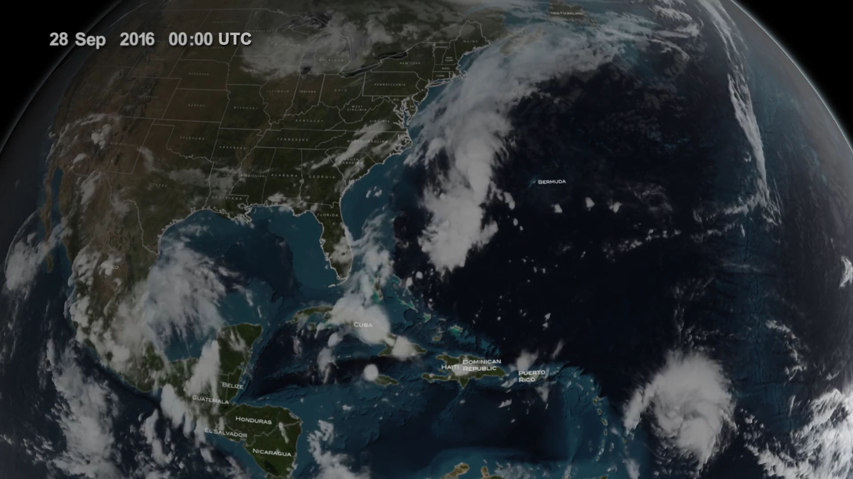
Notes:
GPM Captures Hurricane Matthew Over Haiti
In 2016, Hurricane Matthew was a very powerful, long-lived and deadly tropical cyclone that became the first Category 5 Atlantic hurricane since Hurricane Felix in 2007. The storm travelled across the Western Atlantic, including parts of Haiti, Cuba, Dominican Republic and Lucayan Archipelago, the southeastern United States, and the Canadian Maritimes.
This animation starts with an overview of the North America, Central America, and Caribbean, slowly moving towards Hurricane Matthew as it begins to form. By the morning of October 2, 2016, Matthew was a Category 4 hurricane immediately south of Haiti and the Dominican Republic. GPM’s Time then slows down to show a swath of precipitation data from the Global Precipitation Measurement (GPM) Core Observatory, including a three-dimensional view from the GPM’s Dual-frequency Precipitation Radar (DPR) instrument. These data review the structure of the storm and also the precipitation rates. The GPM Core passed over the storm again on October 3. The GPM mission is helping to advance our understanding of Earth's water and energy cycle, improve forecasting of extreme events that cause natural hazards and disasters, and extend current capabilities in using accurate and timely information of precipitation to directly benefit society.
For more information, visit:
svs.gsfc.nasa.gov/4508

