Slide 1
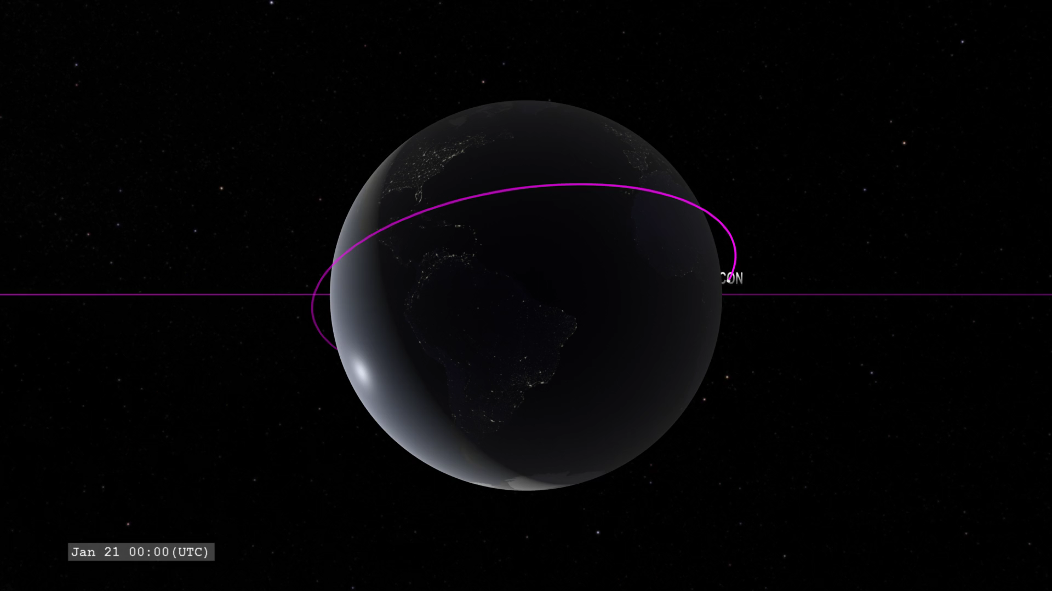
Notes:
Exploring the Ionosphere: ICON and GOLD
This animations shows a view of Earth from the point-of-view of the GOLD (Global-scale Observations of the Limb and Disk) instrument in geostationary orbit. This mission will conduct measurements of ionospheric composition to better understand the connection between space weather and its terrestrial impacts.
ICON (Ionospheric Connections Explorer) is in a low-earth orbit. ICON flies through the ionosphere, measuring its temperature and composition, and studying how winds interact with it. The GOLD instrument will study many of the same things as ICON, but from far above, giving us an additional perspective. GOLD will also look at how starlight passes through the very edges of Earth’s atmosphere, letting us study the ionosphere’s composition at all altitudes.
The colors over Earth in this animation represent model data from the IRI (International Reference Ionosphere) model of the density of the singly-ionized oxygen atom at an altitude of 350 kilometers. Red represents high density. The ion density increases during the daytime because of solar ultraviolet radiation, high-altitude winds, and the Earth's magnetic field. The ion density decreases at night as the ions recombine with free electrons. At the limb of Earth, we present a cross-sectional profile of the density enhancement.
For more information: svs.gsfc.nasa.gov/4503

