Slide 1
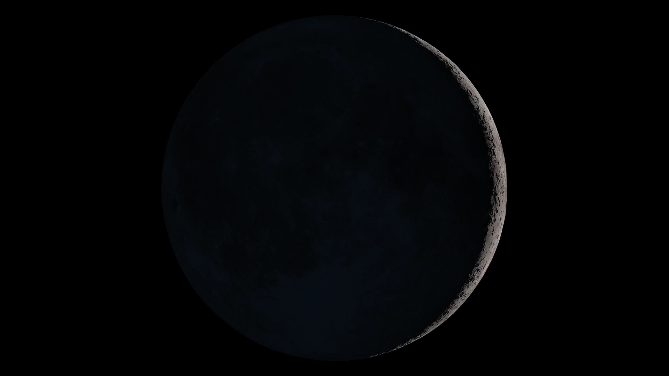
Notes:
This short looping animation shows a complete cycle of lunar phases. The view is geocentric, lunar north up. The frames are at intervals of 3 hours, with a total length of 236 frames representing a synodic month of 29.5 days. To find the frame number corresponding to a particular age in days, use the formula
frame number = ( days × 8 ) + 1
The depiction of phases here is idealized: It ignores both libration and subsolar latitude. In effect, it assumes that the Moon's orbit is perfectly circular and that both its orbit and its equator are in the plane of the ecliptic. In reality, the Moon's orbit is an ellipse inclined 5.1° to the ecliptic, and its axis is tilted another 1.5° from its orbit. These conditions combine to make the Moon's true cycle of phases more complex than what is shown here. See for example this visualization of lunar phases and libration for 2015.

