Slide 1
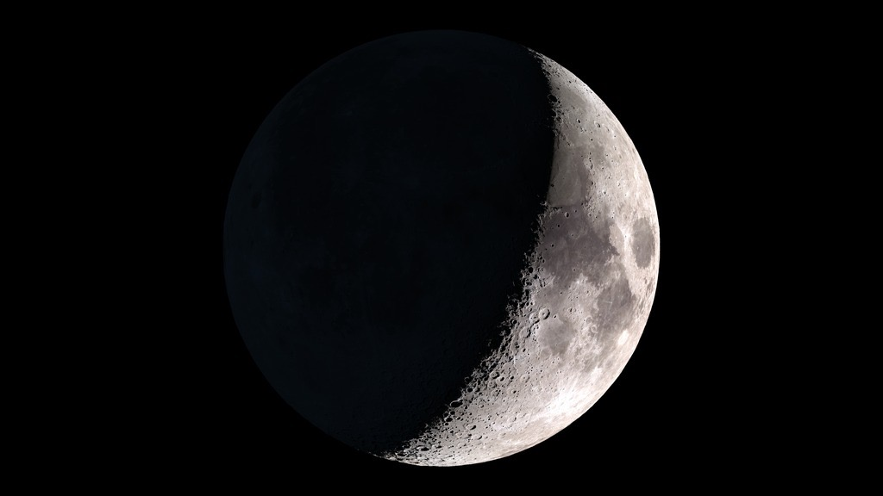
Notes:
Visualization of the Moon as viewed from Earth at the time of the Apollo 17 Moon landing, December 11, 1972 at 19:55 UTC.

Slide 2
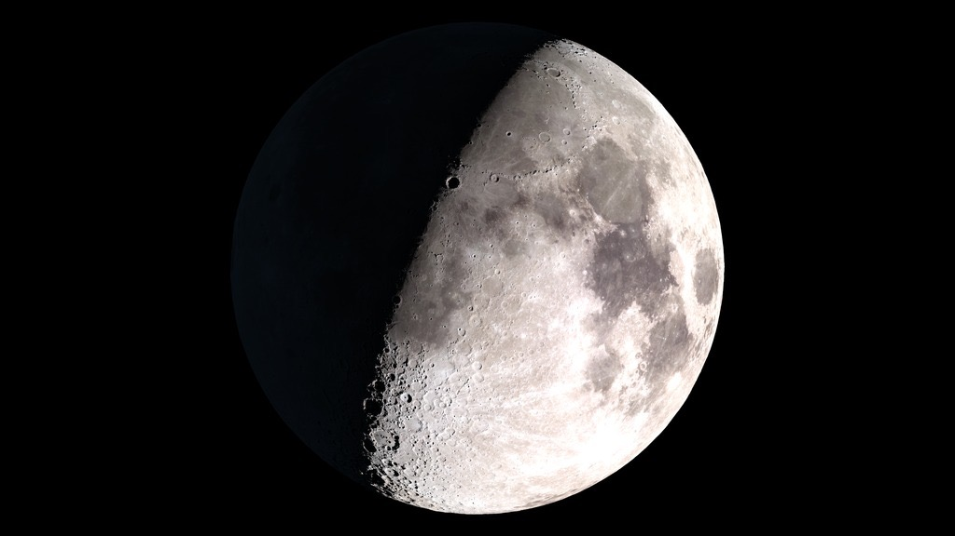
Notes:
Visualization of the Moon as viewed from the Earth at the time of the Apollo 17 return launch (when the LM left the surface of the Moon), December 14, 1972 at 22:55 UTC.

Slide 3
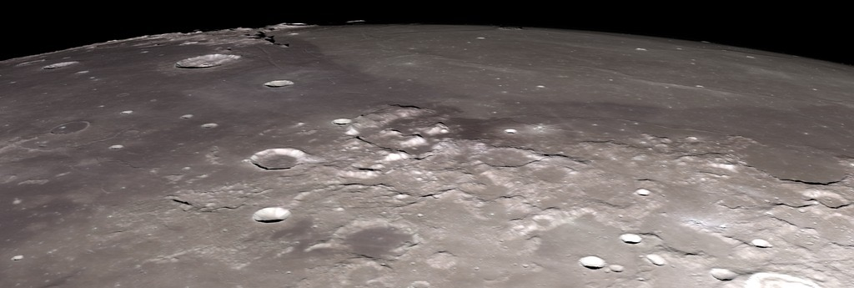
Notes:
A flyover visualization of the Taurus-Littrow Valley looking due west, with the Sun angle at the time of the Apollo 17 landing. This uses a 32-degree square inset of LOLA data at 512 points per degree (roughly 60 meters per pixel).

Slide 4
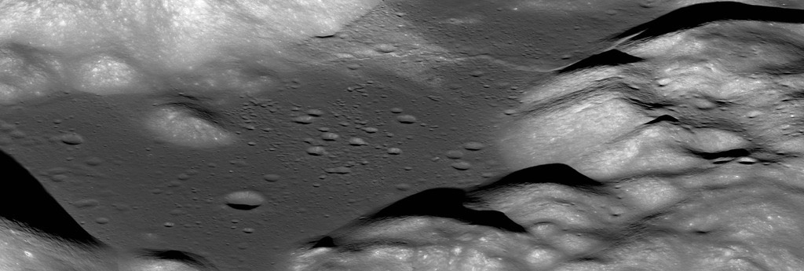
Notes:
An oblique image of the Taurus-Littrow valley taken by the LRO narrow-angle camera. This was cropped from M192703697LR. The Apollo 17 LM descent stage shadow is precisely centered in the image. The resolution is about 4 meters per pixel.

Slide 5
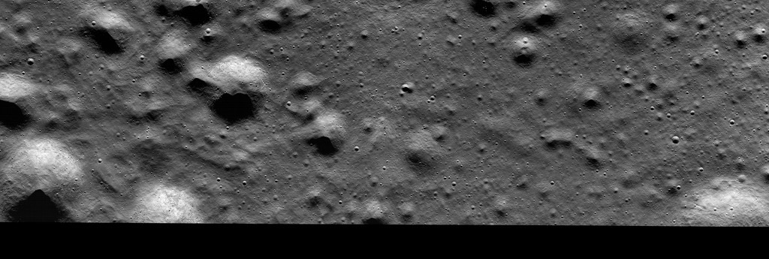
Notes:
A nadir view of the Apollo 17 landing site taken by the LRO narrow-angle camera. West is up, north is to the right. The early morning Sun angle is similar to the lighting at the time of the landing. The resolution is about 0.48 meters per pixel. This is part of M162107606L.

Slide 6
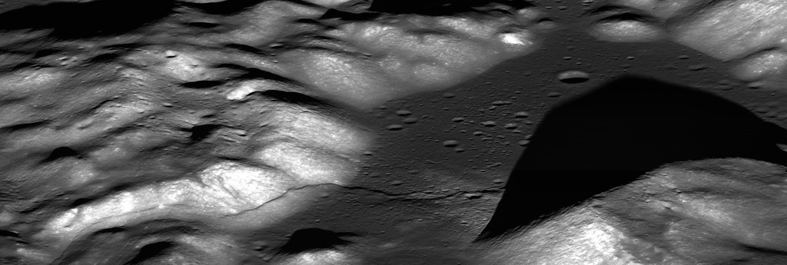
Notes:
A “reverse-angle” oblique view of Taurus-Littrow taken July 7, 2012, cropped and scaled from M1096343661. Looking east (slew angle 56°) with afternoon Sun (subsolar longitude 48°W).

Slide 7
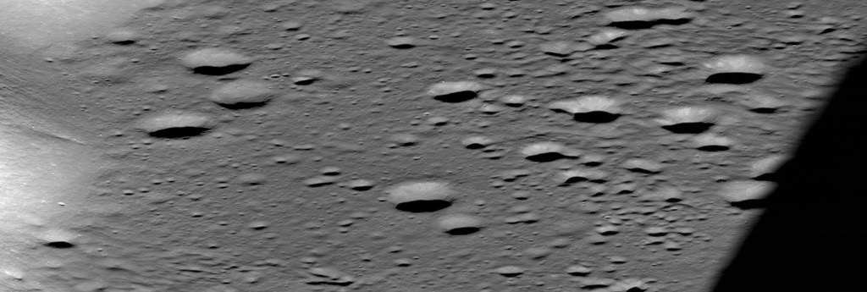
Notes:
A full resolution detail from the “reverse-angle” view of Taurus-Littrow, centered on the LM descent stage. The horizontal resolution is roughly 0.75 meters per pixel.

Slide 8
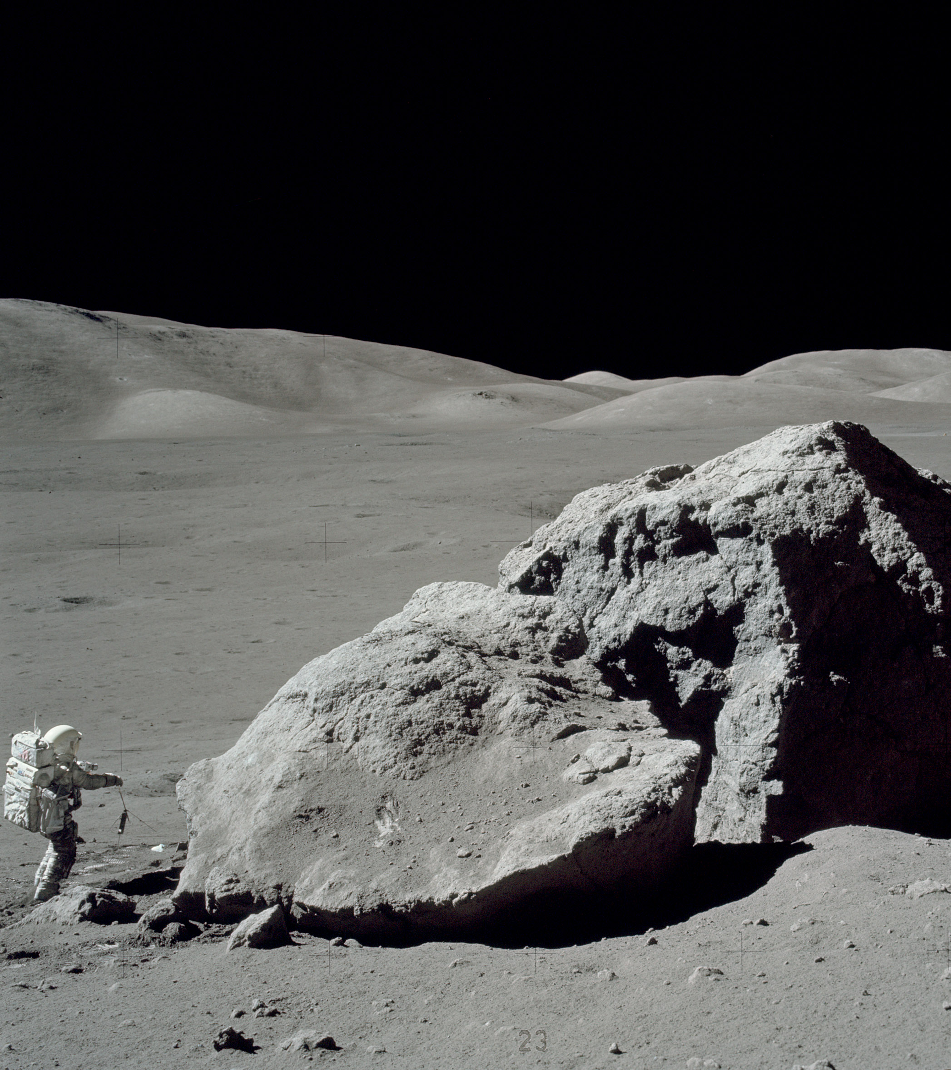
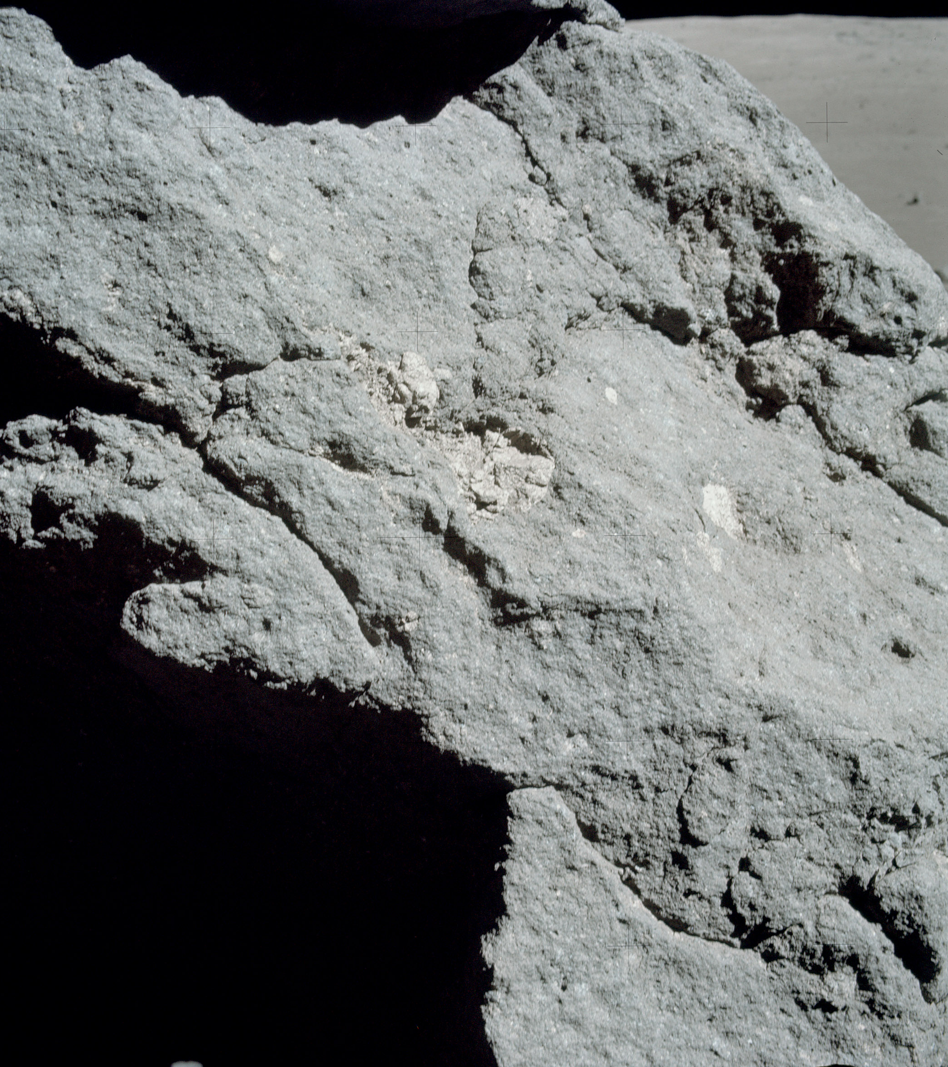
Notes:
At Station 6, the astronauts collected samples from a boulder that had rolled down the side of the North Massif. The LROC image is a detail from M134991788R. See also this LROC featured image blog post.

Slide 9
Notes:
Panoramic image of the landing site.

Slide 10
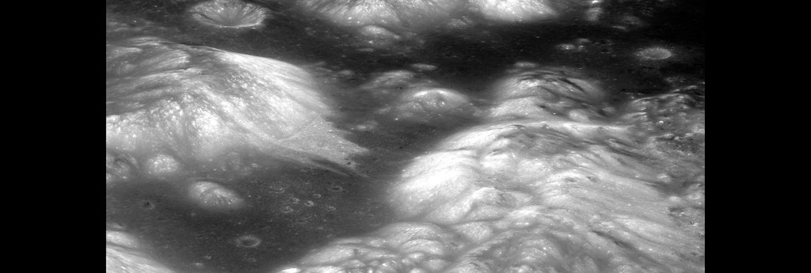
Notes:
Another oblique image (M1182232465LE) of the Taurus-Littrow valley taken by the LRO narrow-angle camera on March 29, 2015.

Slide 11
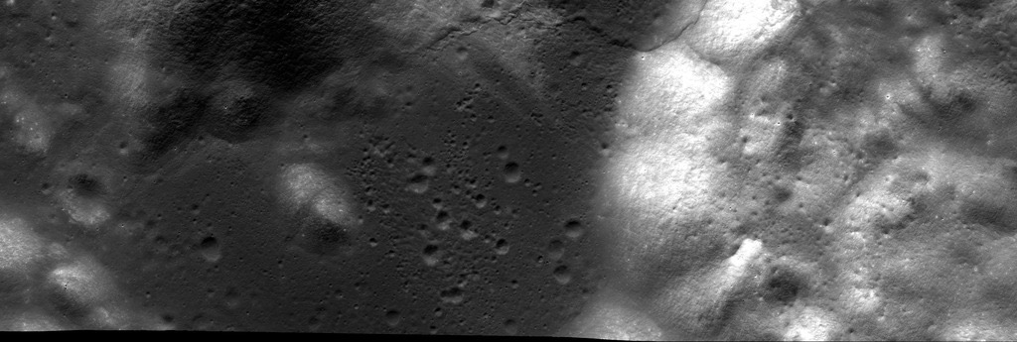
Notes:
A nadir view of the Apollo 17 landing site derived from a mosaic of LRO narrow-angle camera images. West is up, north is to the right. The LM descent stage is centered horizontally and about two-thirds of the way down (y = 1983 pixels).

Slide 12
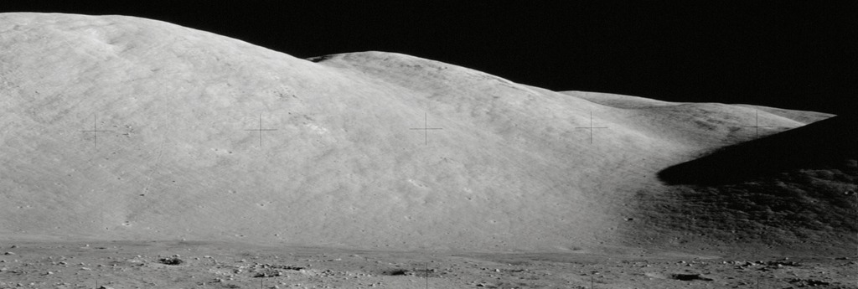
Notes:
AS17-134-20430, a panoramic view of the North Massif from Station 1, taken during the first EVA.

Slide 13
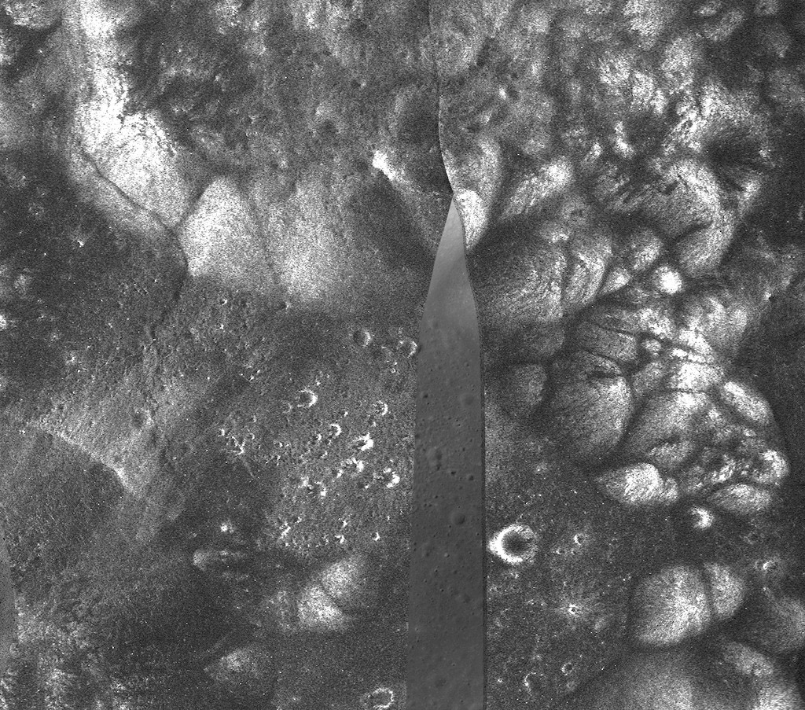
Notes:
Radar image mosaic of Taurus-Littrow from LRO's Mini-RF instrument. Missing data has been filled in with data from an LROC NAC frame.

