Slide 1
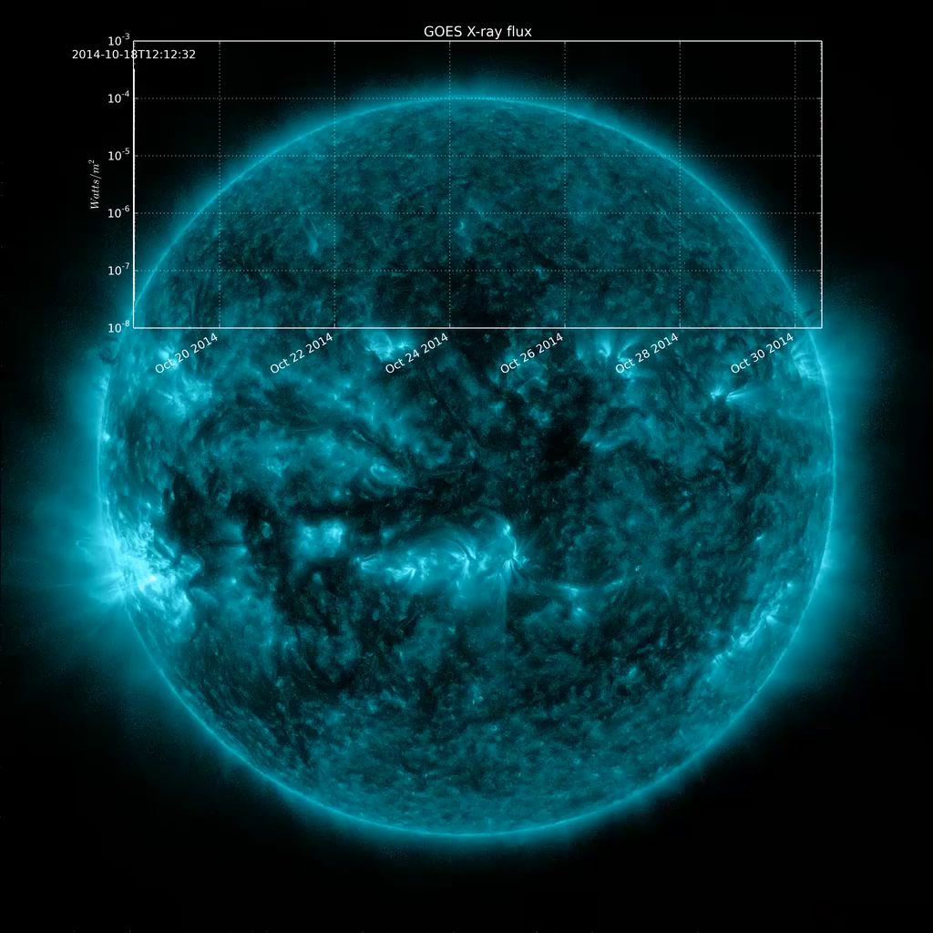
Notes:
The large active region AR12192 is carried across the solar disk by the Sun's rotation. The region erupted with a large number of M and an X-class flares.
Flare classification is defined by the measured X-ray flux from a detector on the GOES satellites (see Classifying Solar Eruptions).
This visualization was the result of some experiments to present both the SDO imagery and GOES X-ray flux as part of a single movie.
This visualization will have three hyperwall shows a top, middle and bottom to choose from

