Slide 1
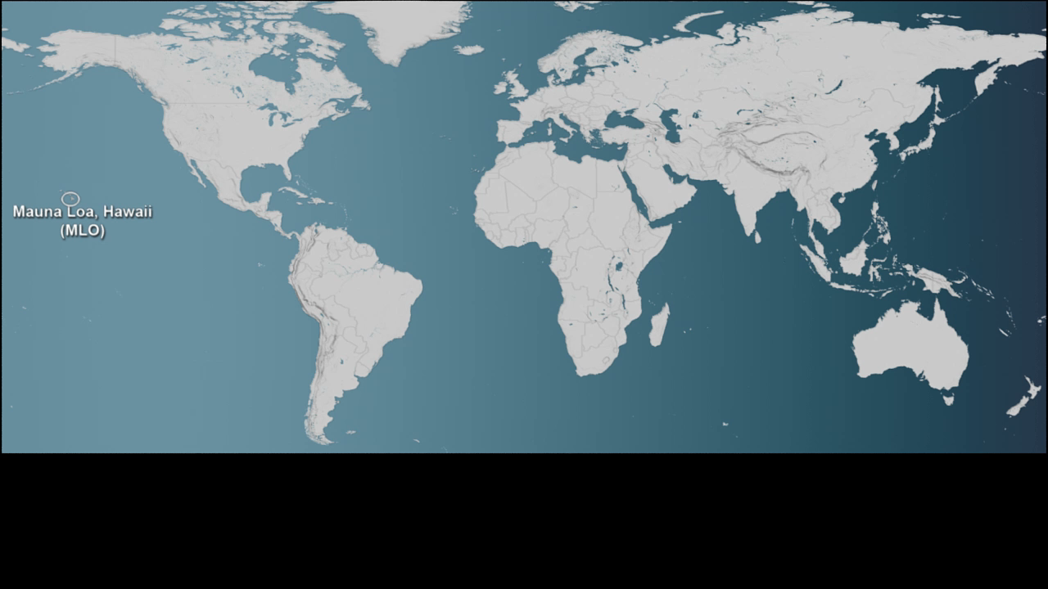
Notes:
AQUA/AIRS CARBON DIOXIDE, 2002-2009, WITH MAUNA LOA CARBON DIOXIDE GRAPH
SVS CATALOG 3685
Aqua - Atmospheric Infrared Sounder (AIRS)
This visualization is a time-series of the global distribution and variation of mid-tropospheric carbon dioxide concentrations observed by the Atmospheric Infrared Sounder (AIRS) on NASA’s Aqua spacecraft. For comparison, it is overlain by a graph of the seasonal variation and interannual increase of carbon dioxide observed at the Mauna Loa Observatory in Hawaii. The AIRS data show the average concentration (parts per million) over an altitude range of 3 km to 13 km, whereas the Mauna Loa data show the concentration at an altitude of 3.4 km and its annual increase at a rate of approximately 2 parts per million (ppm) per year.
The two most notable features of this visualization are the seasonal variation of CO2 and the trend of increase in its concentration from year to year. The global map clearly shows that CO2 in the northern hemisphere peaks in April-May and then drops to a minimum in September-October. This seasonal cycle is governed by the growth cycle of plants. The northern hemisphere has the majority of the land masses, and so the amplitude of the cycle is greater in that hemisphere. The overall color of the map shifts toward the red with advancing time due to the annual increase of CO2.

