Slide 1
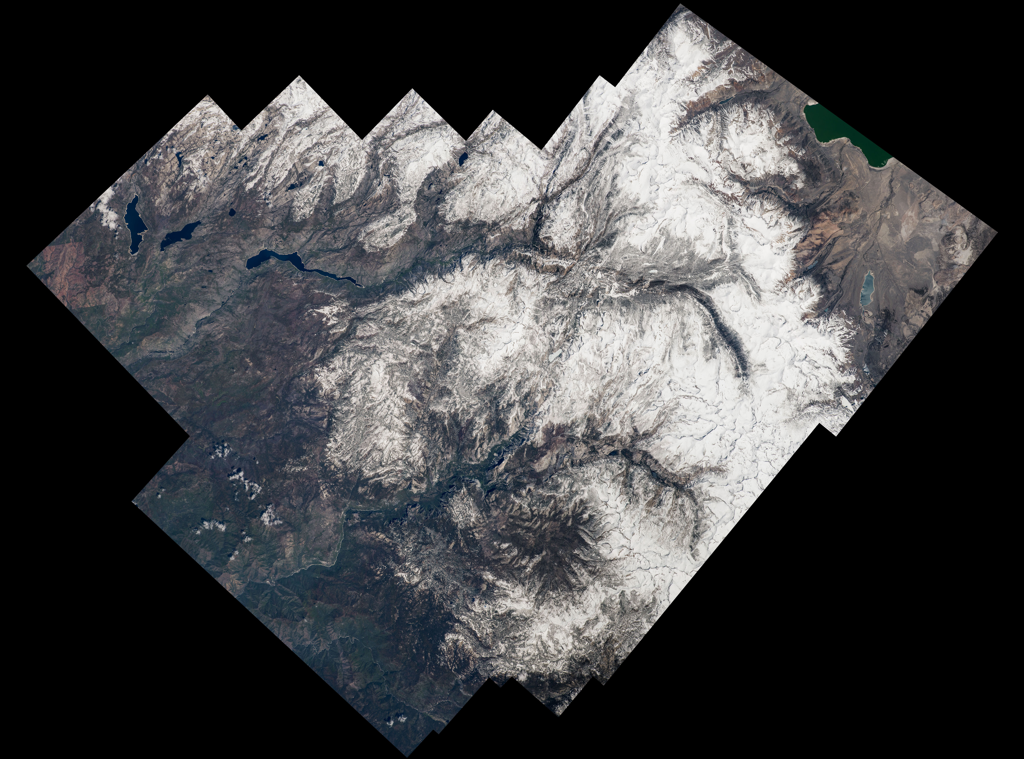
Notes:
Highlighting National Parks on the National Park Service Centennial
Expedition 48 Commander Jeff Williams of NASA marked the centennial of the U.S. National Park Service by capturing a series of photographs of national parks from his vantage point in low Earth orbit. On July 19, 2016, Williams shared this composite image of a wide view as well as a panorama video of Yosemite National Park.
For more information:
www.nasa.gov/content/space-station-view-of-us-national-parks

