Slide 1
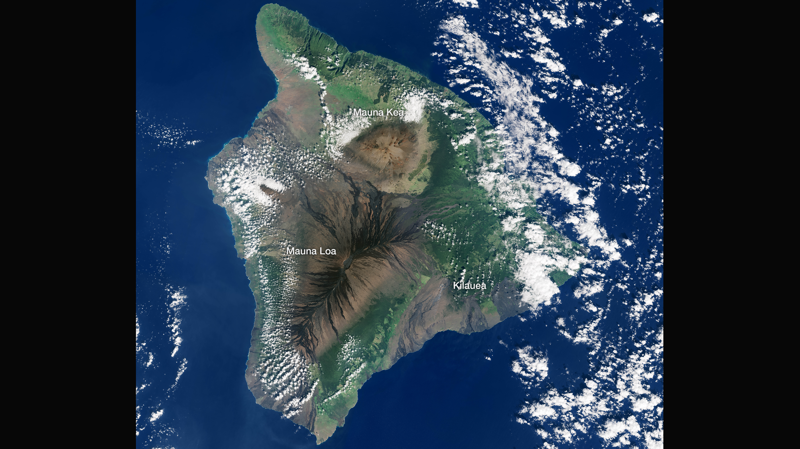
Notes:
Highlighting National Parks on the National Park Service Centennial
Volcanoes National Park, mosaic of images acquired by Landsat 8 OLI between December 15, 2013 - January 18, 2014
For more information:
earthobservatory.nasa.gov/IOTD/view.php?id=88495

