Slide 1
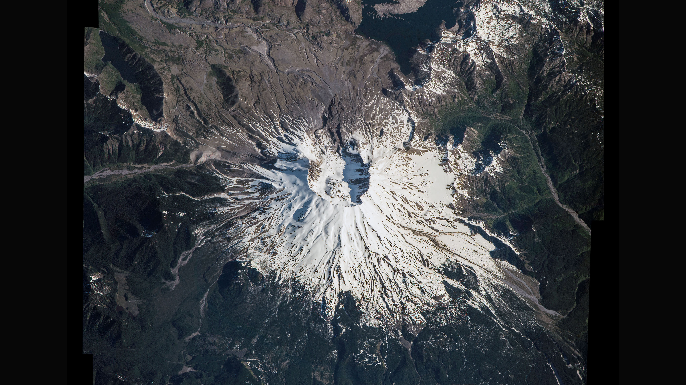
Notes:
Highlighting National Parks on the National Park Service Centennial
Marking the centennial of the U.S. National Park Service, Expedition 48 Commander Jeff Williams of NASA photographed the Mount St. Helens National Volcanic Monument from his vantage point aboard the International Space Station. Posting both a composite image and panorama video to social media, Williams wrote, "<b>Mount St. Helens</b> looks spectacular from directly above! #FindYourPark #NPS100"
For more information:
https://www.nasa.gov/image-feature/space-station-flyover-of-mount-st-helens

