Slide 1
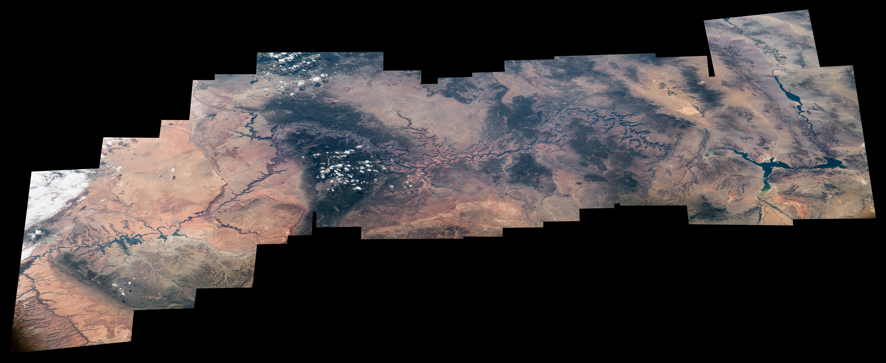
Notes:
Highlighting National Parks on the National Park Service Centennial
To celebrate the centennial of the U.S National Park Service, Expedition 48 Commander Jeff Williams of NASA has taken hundreds of images of national parks from his vantage point in low Earth orbit, aboard the International Space Station. Here, a series of Williams' photographs are assembled into this composite image of the <b>Grand Canyon</b>. Sharing with his social media followers, Williams wrote, "The mighty @grandcanyonnps adorns the Arizona desert. #FindYourPark #NPS100."
For more information:
www.nasa.gov/content/space-station-view-of-us-national-parks

