Slide 1
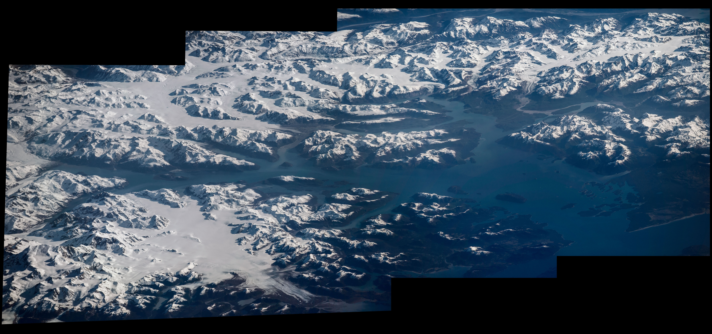
Notes:
Highlighting National Parks on the National Park Service Centennial
NASA astronaut Jeff Williams captured the photographs, assembled into this composite image, during his Expedition 47/48 mission aboard the International Space Station. Sharing the image on social media, Williams wrote, "A place of inspiration,@GlacierBayNPS. #FindYourPark #NPS100."
For more information:
www.nasa.gov/content/space-station-view-of-us-national-parks

