Slide 1
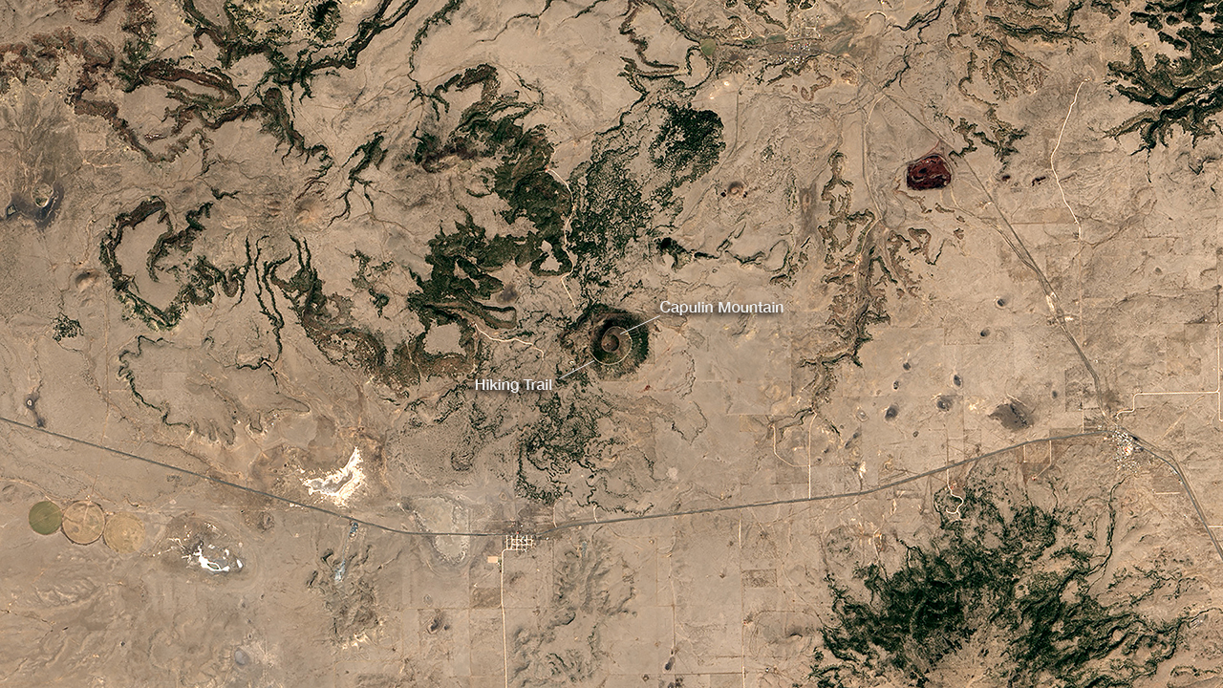
Notes:
Highlighting National Parks on the National Park Service Centennial
Capulin Volcano National Monument, acquired by Landsat 8 OLI on April 4, 2016
For more information:
http://earthobservatory.nasa.gov/IOTD/view.php?id=88581

