Slide 1
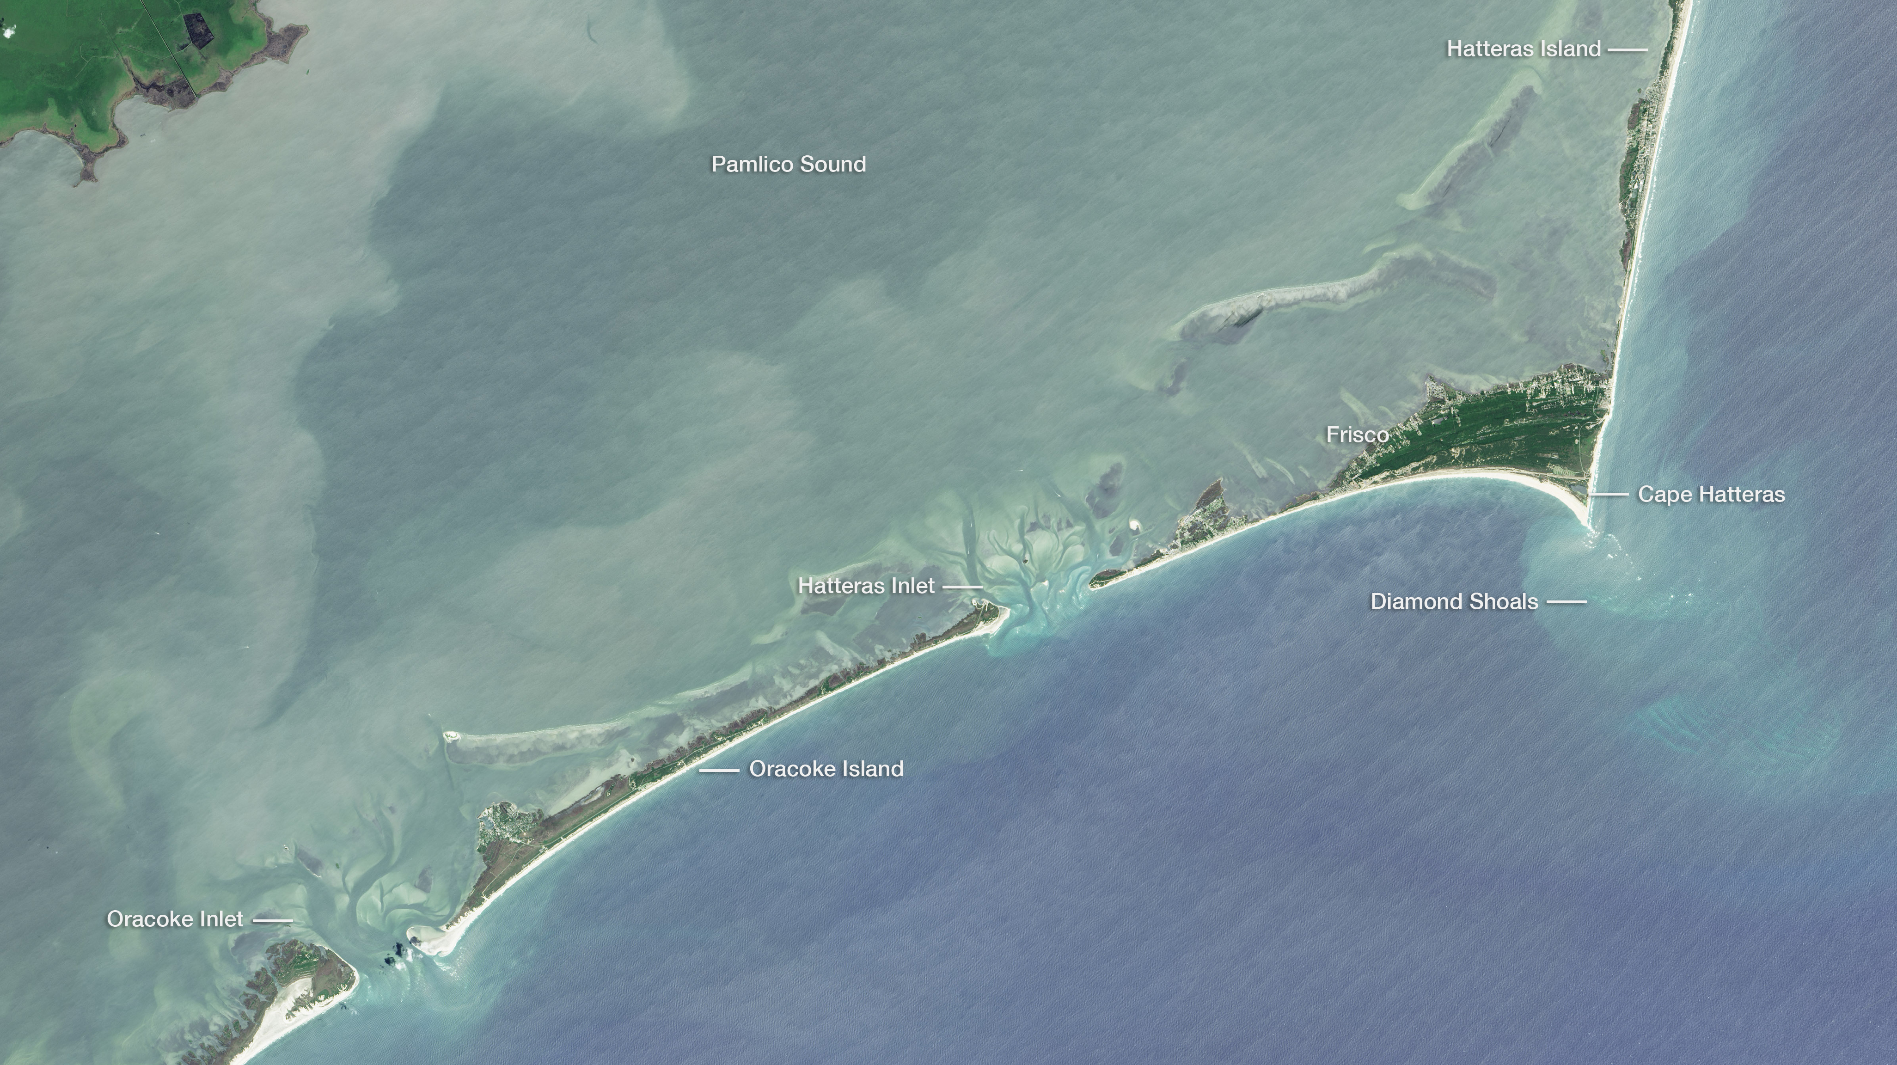
Notes:
Highlighting National Parks on the National Park Service Centennial
Cape Hatteras National Seashore, acquired by Landsat 8 OLI on June 7, 2015
For more information:
http://earthobservatory.nasa.gov/IOTD/view.php?id=88619

