Slide 1
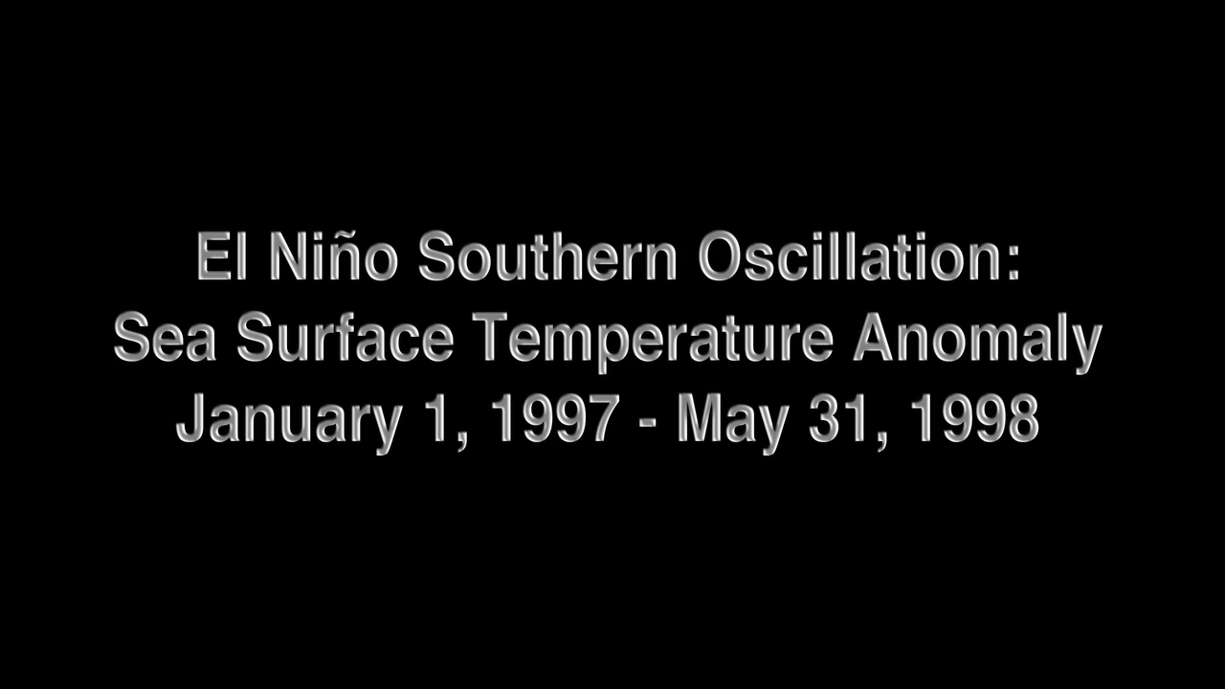
Notes:
ENSO Sea Surface Temperature Anomalies: 1997-1998
This animation illustrates the evolution of sea surface temperature (SST) anomalies (relative to the respective normal state) in the Pacific Ocean associated with the 1997-98 El Niño, the warm phase of an interannual mode of climate variability called El Niño-Southern Oscillation, or ENSO. SST anomalies reflect the heat content in the mixed layer (upper 50 meters of the ocean). This product uses optimal interpolation (OI) using data from the 4 km Advanced Very High Resolution Radiometer (AVHRR) Pathfinder Version 5 time series (when available, otherwise operational NOAA AVHRR data are used) and in situ ship and buoy observations.
Initial warming appeared in the eastern equatorial Pacific around May 1997 and grew into a strong El Niño event by the end of the year. In fact, the 1997-98 El Niño was the strongest on record, and it developed more rapidly than any El Niño of the past 40 years. The event impacted weather, marine ecosystems, and fisheries.
Instrument: AVHRR

