Slide 1
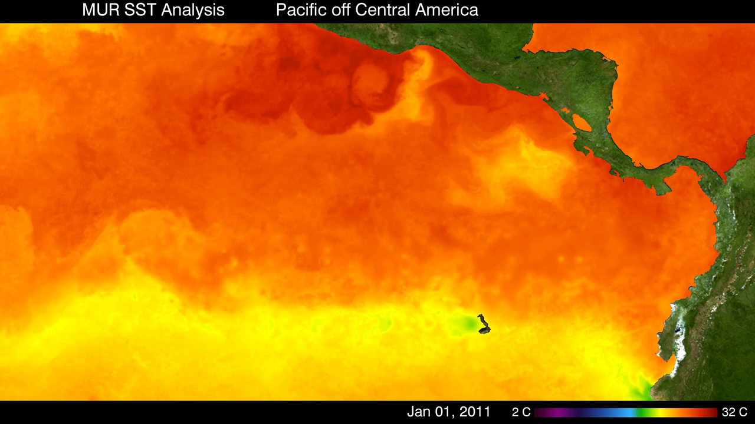
Notes:
This visualization from January 1, 2011 to December 31, 2013 shows sea surface temperatures (SST) in the Eastern Pacific near Central America at 1-kilometer (~0.6 mile) resolution. Cold eddies associated with the winds that blow through the mountain gaps in Central America, near Costa Rica and Southern Mexico for example, are clearly visible.
The Multi-scale Ultra-high Resolution (MUR) SST dataset, used to create this visualization, combines data from the Advanced Very High Resolution Radiometer (AVHRR), Moderate Resolution Imaging Spectroradiometer (MODIS), Advanced Microwave Scanning Radiometer for EOS (AMSR-E) instruments, and currently the U.S. Navy’s WindSat spacecraft.
Satellite: U.S. Navy’s WindSat spacecraft, Aqua, Terra, NOAA-15
Instruments: MUR, AVHRR, MODIS, AMSR-E

