Slide 1
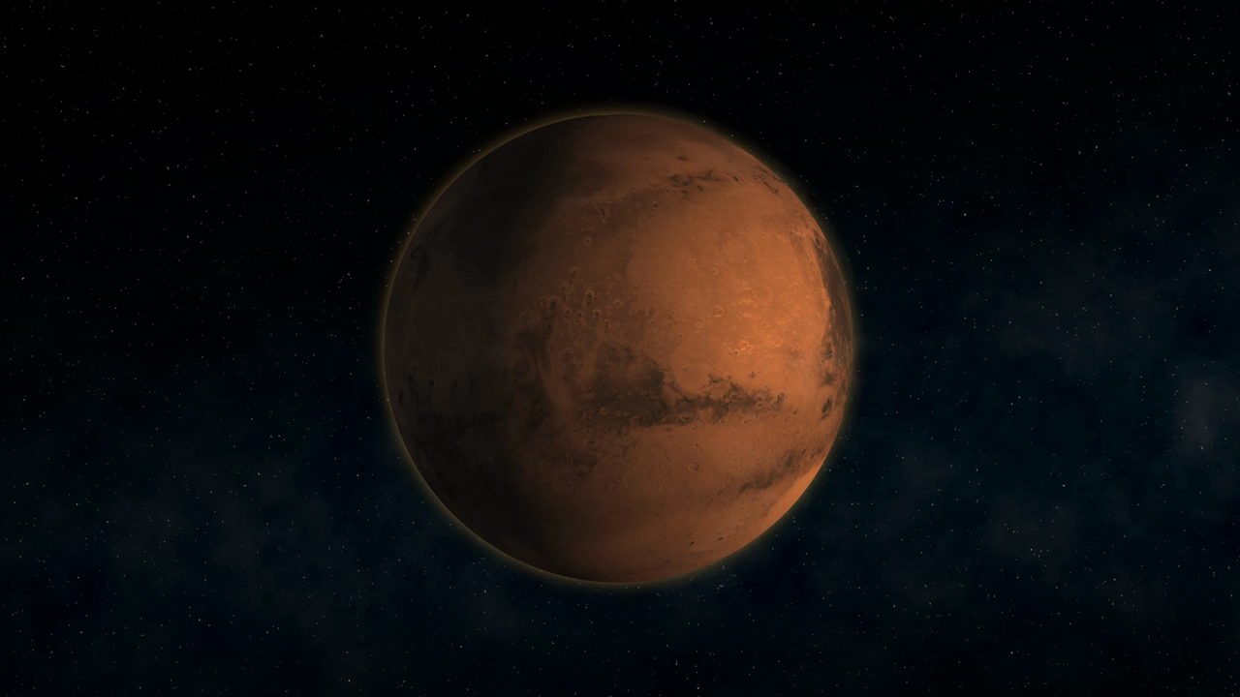
Notes:
Since our first close-up picture of Mars in 1965, spacecraft voyages to the Red Planet have revealed a world strangely familiar, yet different enough to challenge our perceptions of what makes a planet work. Every time we feel close to understanding Mars, new discoveries send us straight back to the drawing board.
Over the past several decades, spacecraft have shown us that Mars is rocky, cold, and desolate beneath its hazy, pink sky. We've discovered that today's Martian wasteland hints at a formerly volatile world where volcanoes once raged and flash floods rushed over the land.
Among our many discoveries about Mars, one stands out above all others: the evidence for past surface water on Mars. Water is key because almost everywhere we find water on Earth, we find life. With our robotic spacecraft, we've found evidence that liquid water once flowed in ancient Martian environments that could have supported microbial life. Armed with that knowledge, we now can seek signs of whether such life actually arose. Is there any evidence of life in the planet's past? If so, could any of these tiny living creatures still exist today? Imagine how exciting it would be to answer, "Yes!!"
Hardware: viking visual imaging subsystem

