Slide 1
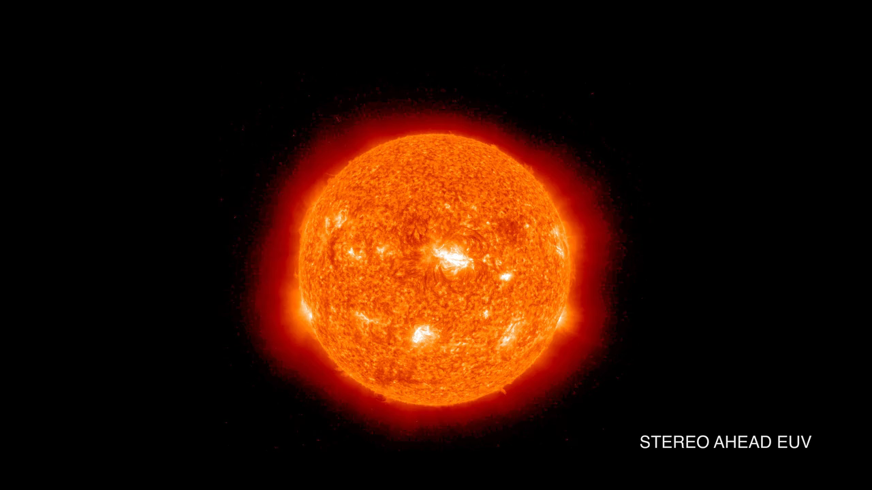
Notes:
On May 1, 2013, NASA's Solar Terrestrial Relations Observatory Ahead (STEREO-A) satellite along with its twin STEREO Behind (STEREO-B), observed an active region (right) of the sun erupt. This eruption, called a coronal mass ejection, or CME, sent plasma streaming out through the solar system.
STEREO has an extreme ultraviolet camera similar to the Solar Dynamics Observatory (SDO) satellite, but it also has coronagraph telescopes like the European Space Agency/NASA Solar and Heliospheric Observatory (SOHO) where the bright sun is blocked by a disk so it does not overpower the fainter solar atmosphere. As a result, using its two inner coronagraphs, STEREO was able to track the CME from the solar surface out to 6.3 million miles.

