Slide 1
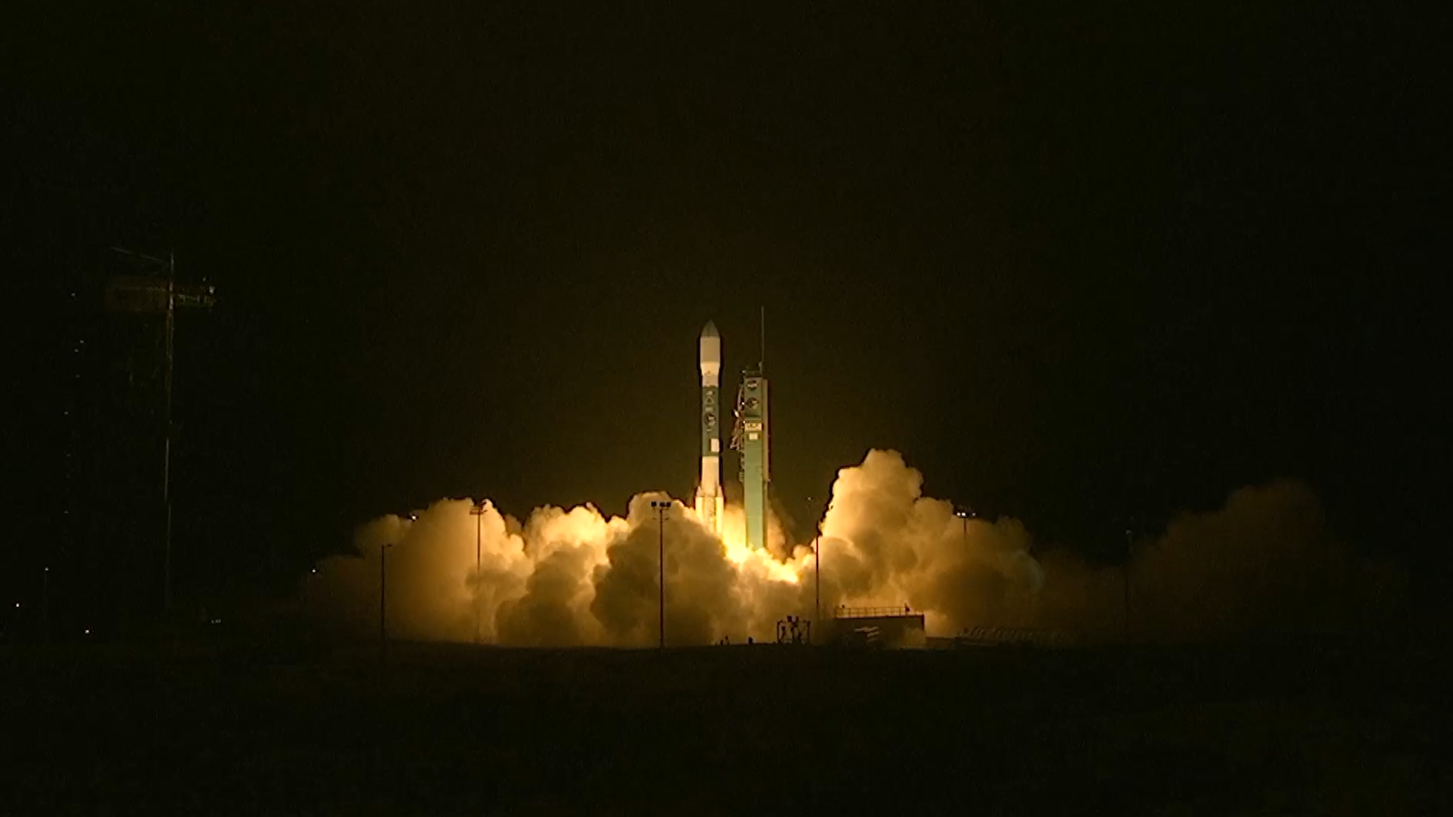
Notes:
LEAD: NASA launched a new Earth-observing satellite over the weekend (Saturday, January 31, 2015) from Vandenberg Air Force Base in California.
1. The satellite's unique 20-foot spinning radar will measure the amount of water in the top two inches of soil around the world, every three days.
2. This information is important because the evaporation of water in soil affects how storm clouds develop.
3. Soil moisture data will assist forecasters to make better predictions of floods and droughts.
TAG: Monitoring worldwide changes to soil moisture will help scientists predict future weather and climate.

